Slide 1

Dorchester Sailing Club
Paperless race management system
Step-by-step guide
https://racing.dorchestersailingclub.org.uk
Version 1.2

Slide 2
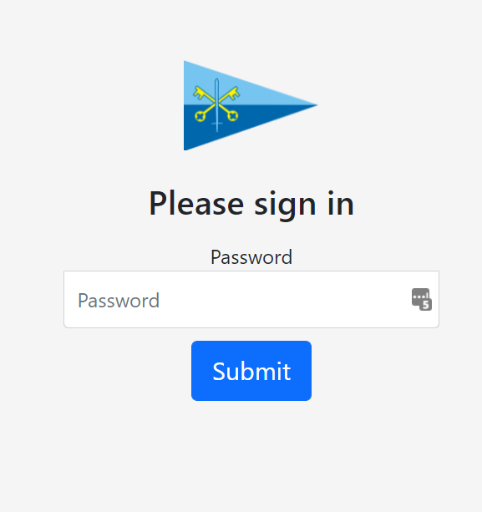
Log into the OOD page
Press ‘OOD page’ on the homepage
Enter ‘laser’ when asked for a password

Slide 3
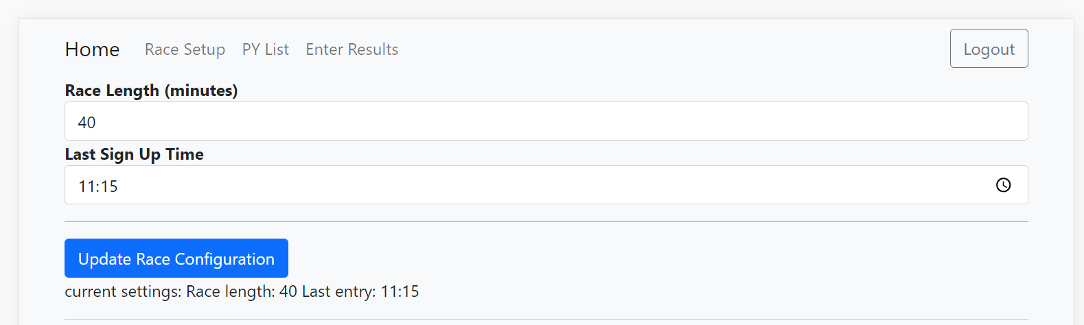





Adjust race setup (if required – shouldn’t need changing)
Use the ‘Race length’ field to adjust the time the race will last for the slowest boat.
You can change the ‘Last sign up time’ to prevent any entries after this time.
Click ‘update race configuration’ to save these changes

Slide 4
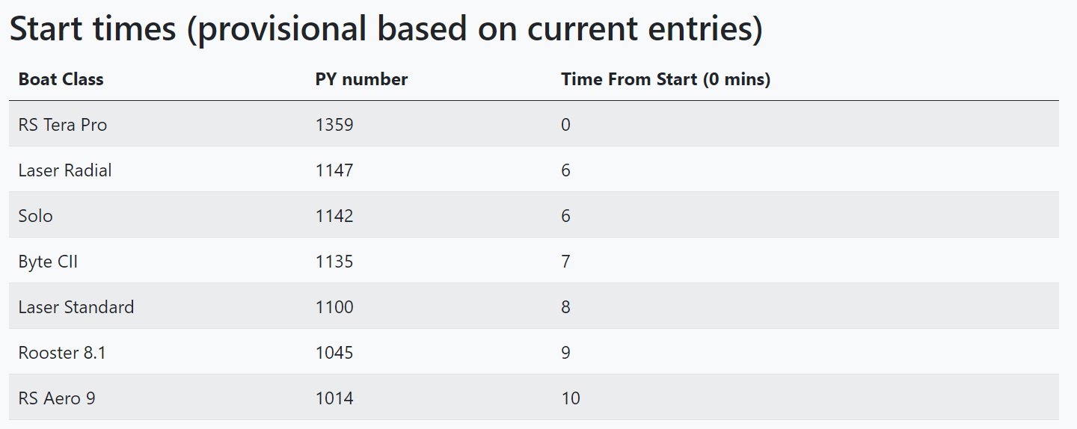
Check the start times
On the same page as the race setup, the start times are displayed. These must be followed to ensure accurate results.
Update the whiteboard to display start times once either a topper/tera/gull have signed up or entries have closed at 11:15.

Slide 5
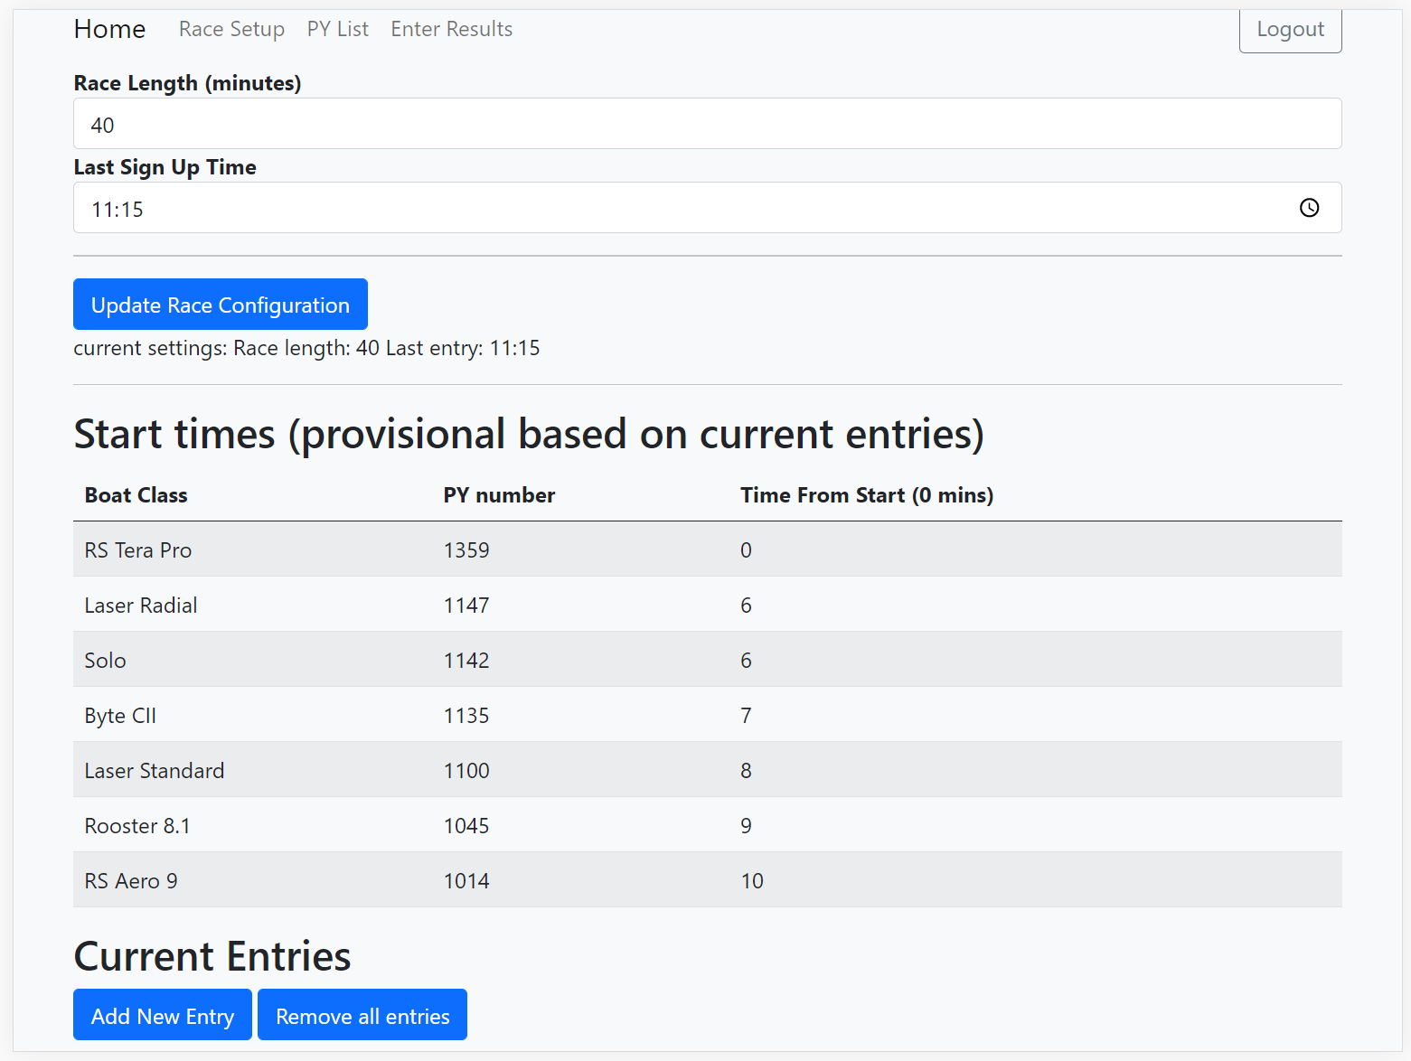


Add an entry
To add an entry for someone who can’t themselves, you should press ‘Add new entry’ on the race setup page and press ‘Register’.

Slide 6
Racing
To run the race, you must include a ‘lapping mark’ in the course. This should be reasonably close to the clubhouse (e.g. ODM, or buoy 1) so you can easily see boats as they round/pass it.

Slide 7
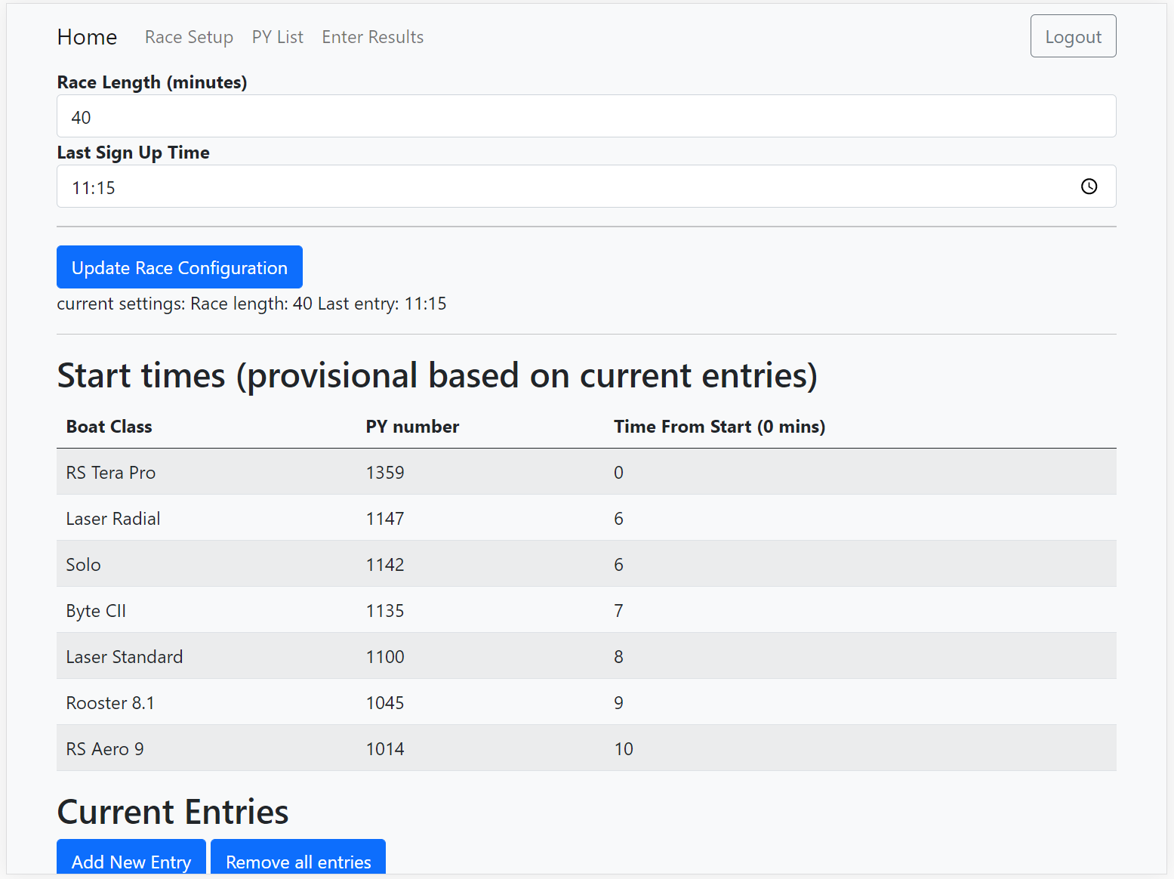
Starting the race
To start the race, begin by doing a normal 5-4-1-GO start sequence, then hoot the horn at every time listed in the ‘Start times’ table.

Slide 8



Enter results
Change to the enter results page by pressing ‘Enter results’ on the top navigation bar

Slide 9
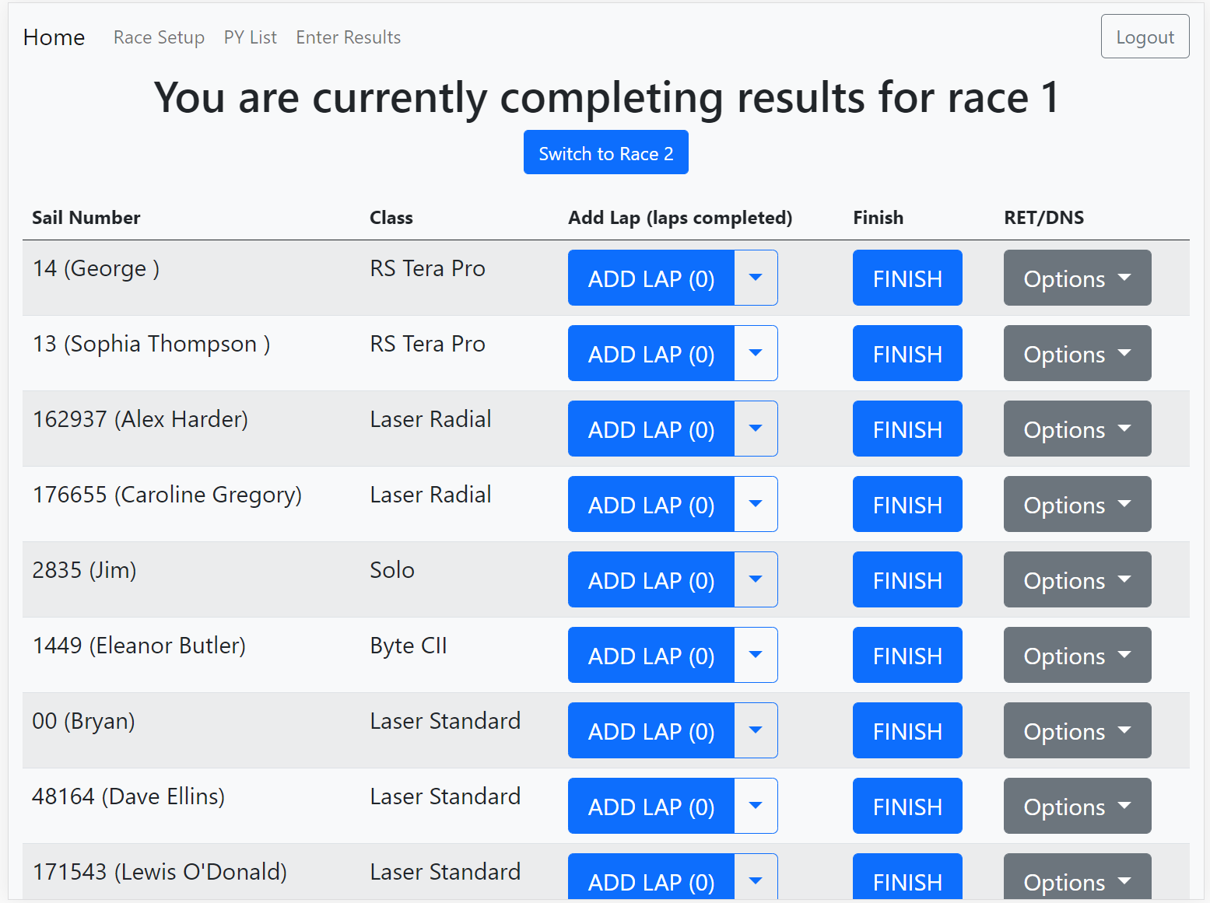

If a boat retires or doesn’t start
Use the options button to retire or mark someone as ‘did not start’

Slide 10


Completing results
When each boat rounds the lapping mark, press the ‘Add Lap’ button for the relevant boat. The number of laps completed is shown in brackets.

Slide 11
Completing results
Just before the race time is complete, go onto the water with a clipboard and paper, and drive to the lapping mark
Once the race time is complete, drive from the lapping mark backwards around the course noting the sail numbers of every boat in the order they are on the water.
It may be helpful for the AOD to continue to note boats passing the lapping mark until the hooter signaling the end of the race is sounded. After this no laps should be added.
See the diagram on the next page

Slide 12


Diagram of how to finish
Regardless of which boat is in the lead, the order in which the boats should be recorded in is:
Green
Blue
Grey
Yellow
Lapping line

Slide 13

Completing results
Once back on the shore, go down the list of sail numbers on the paper pressing finish on the relevant row IN THE SAME ORDER!

Slide 14
Viewing the results
The final results for the race can be viewed at the race results page found on the homepage.

Slide 15

Switch to race 2
Once race 1 is finished, press the ‘Switch to race 2’ button.
The same start sequence should be used for race 2.
Identify who isn’t starting the second race and mark them as DNS.

